Slide 1
APPLICATION OF DISCRIMINANT ANALYSIS FOR PREDICTING MEDICAL DIAGNOSIS IN DECISION SUPPORT SYSTEM
GUIDE: Dr. R. Subhash Moorty
CO-GUIDE: Dr. O. S. Deepa Gopakumar

Slide 2
LITERATURE SURVEY
Halil Yigit had worked on ABC- based distance–weighted kNN algorithm [7].
Xuejun Ma, et.al [13] studied on a variant of K nearest neighbour quantile regression.
Some of the related works based on KNN and Discriminant Analysis can be found in [1, 8, 9, 10, 11, 12].
The working of this project is based on the study of molecular descriptors for Drug/Non-Drug compounds extracted from medicinal plants. The molecular descriptors of these chemical compounds are identified by Dr. O. S. Deepa Gopakumar and Ani R. They have studied a lot on the classification of the compounds extracted from the medicinal plants [2, 3, 4, 5, 6].
Descriptions of the same can be found in [15, 16].
The machine learning approaches like classification of these compounds to drug compounds and non drug compounds are done by Kormaz, Selcuk, Gokmen Zararsiz, and Dincer Goksusluk [14].
Descriptions of machine learning approaches are also found in [17].

Slide 3
OVERVIEW OF KNN CLASSIFIER
This classifier does classification using instance based learning
KNN stands for k-nearest neighbours
This algorithm consists of two phases – training phase and testing phase
Training phase consists only of storing the feature vectors and class labels of the training sample
K is a user defined parameter which tells us how many neighbours to consider from the testing sample
The distances from each training point to the testing point are calculated
Identify the k-nearest neighbours
Use the class labels of these k-nearest neighbours to determine the class label for the testing sample
The testing sample is assigned the class label of the majority of the k-nearest neighbours

Slide 4
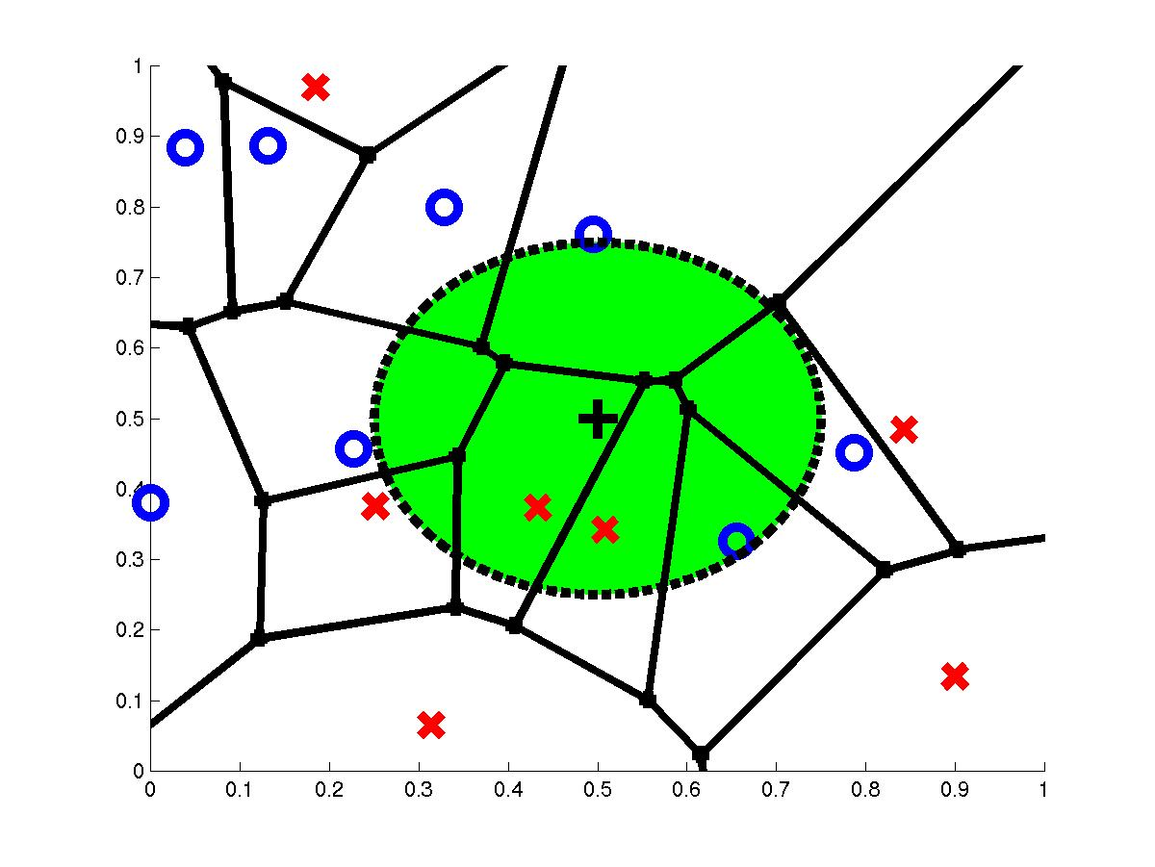
3-Nearest Neighbours
Query Point q_{f}
3 Nearest Neighbours
2x,1o

Slide 5
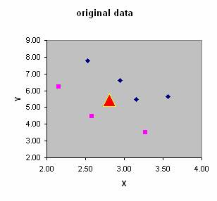
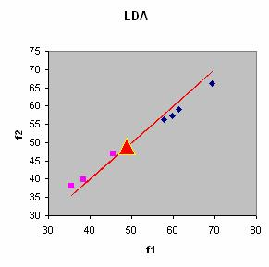
LINEAR DISCRIMINANT ANALYSIS(LDA)
This is a method that helps us find a linear combination of features that splits two classes of objects from each other.
It is a generalization of Fischer’s Linear Discriminant, used in statistics, machine learning and pattern recognition.
The linear combination obtained as a result of LDA can be used as a linear classifier or for dimensionality reduction before classification.
It is closely related to Analysis of Variance(ANOVA), Regression Analysis, Principal Component Analysis(PCA) and Factor Analysis(FA), which also attempt to express a dependent variable in terms of independent variables.
This method is also known as Normal Discriminant Analysis(NDA) or Discriminant Function Analysis(DFA).

Slide 6
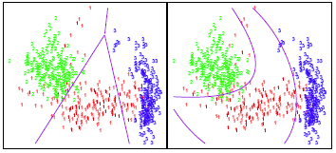
QUADRATIC DISCRIMINANT ANALYSIS(QDA)
This method is used to separate two or more classes of objects from one another.
Instead of a line in the case of LDA, here, we represent the boundary separating the classes as a quadric surface.
We can call this as a more generic version of the linear classifier.
It is used in machine learning and is closely related to LDA.
The measurements from each class are normally distributed like in LDA, but here, we do not assume that the covariance of each of the classes are equal.

Slide 7
USAGE OF LDA AND QDA
LDA tends to be a better bet than QDA if there are relatively few training observations and so has substantially lower variance.
QDA is recommended if the training set is very large, so that the variance of the classifier is not a major concern.
QDA has more predictability power than LDA but it needs to estimate the covariance matrix for each classes.

Slide 8
ALGORITHMS USED
KNN
LDA
QDA
KNN LDA
KNN QDA
FUZZY KNN
FUZZY KNN LDA
FUZZY KNN QDA
ROUGH FUZZY KNN
ROUGH FUZZY KNN LDA
ROUGH FUZZY KNN QDA
CONDENSED KNN
CONDENSED KNN LDA
CONDENSED KNN QDA
CONSTRAINED KNN
CONSTRAINED KNN LDA
CONSTRAINED KNN QDA

Slide 9
FUZZY KNN ALGORITHM
Take m sample vectors with n parameters, say, x1,x2,…,xn which can be assigned to any one of different classes, say, C1,C2,…,Cn. These are considered as training data sets.
For each of training and testing data the distance is calculated by taking the sum of the squares of the distance between each parameter of the training and testing data, i.e., given two vectors x1,x2,…,xn and y1,y2,…,yn.The distance is given by (x1-y1)2+(x2-y2)2+…+(xn-yn)2.
Take the k training data sets with the least values of distance from the training data set.
From the k training data sets obtained above, count how many of these belong to each class.
For each class, create a Boolean vector which assigns a value between 0 and 1.

Slide 10
For each class, calculate the value Ʃ(no of rows in each matrix*Covariance Matrix)/(distance of each training data set from the testing data set). These values are considered as XC1,XC2,…,XCn.
Let Ʃ1/(distance of each training data set from the testing data set). For each class, calculate the value Z=X/Y. Let these values be ZC1,ZC2,…,ZCn.
Assign the class with the highest Z-value to the testing data set.
If two of the classes both share the highest Z-value, then find the closest of the k neighbours belonging to one of these two classes and assign that class to the testing data set.

Slide 11
FUZZY KNN-LDA ALGORITHM
Take m sample vectors with n parameters, say, x1,x2,…,xn which can be assigned to any one of different classes, say, c1,c2,…,cn. These are considered as training data sets.
Take another sample vector, say k, with the same n parameters. We shall call this a testing data set.
For each of training and testing data the distance is calculated by taking the sum of the squares of the distance between each parameter of the training and testing data, i.e., given two vectors x1,x2,…,xn and y1,y2,…,yn.The distance is given by (x1-y1)2+(x2-y2)2+…+(xn-yn)2.
Take the k training data sets with the least values of distance from the training data set.
From the k training data sets obtained above, count how many of these belong to each class.
For each class, store the belonging training data sets in a matrix, where each row of the matrix is a training data set. Call these as class matrices, say C1 and C2.
Calculate the average data set for the training data set in each matrix, say avgC1 and avgC2 for the distance vectors in both matrices, say avg.

Slide 12
Multiply the distance vectors of each of the distance matrices of each class by their membership in that class. We shall call these matrices as d1 and d2.
For each of the class matrices, create new matrices, say C01 and C02, which are obtained by calculating the distance vector between each row of the class matrices and the average vector, avg.
For each class we can calculate the covariance matrix using the formula (G*G’)/(number of rows in G) for any given matrix G. In this case, we shall apply the formula to the matrices C01 and C02 and call the resulting covariance matrices CovC1 and CovC2.
Calculate the pooled covariance matrix, say Cov, which is given by the formula Ʃ(no of rows in each distance matrix*Covariance Matrix)/(no of rows in each distance matrix). Apply this formula to distance matrices d1 and d2 and covariance matrices CovC1 and CovC2.
Calculate the linear model coefficient vector, which is in this case, β=(avgC1-avgC2)/(Cov).
Let X=(K-((avgC1-avgC2)/2)) β’ and Y=-log((number of rows in C1)/(number of rows in C2)).
If X>Y, then assign the class c1 to the testing data set. Otherwise, assign the class c2.

Slide 13
FUZZY KNN-QDA ALGORITHM
Take m sample vectors with n parameters, say, x1,x2,…,xn which can be assigned to any one of different classes, say, c1,c2,…,cn. These are considered as training data sets.
Take another sample vector, say k, with the same n parameters. We shall call this a testing data set.
For each of training and testing data the distance is calculated by taking the sum of the squares of the distance between each parameter of the training and testing data, i.e., given two vectors x1,x2,…,xn and y1,y2,…,yn.The distance is given by (x1-y1)2+(x2-y2)2+…+(xn-yn)2.
Take the k training data sets with the least values of distance from the training data set.
From the k training data sets obtained above, count how many of these belong to each class.
For each class, store the belonging training data sets in a matrix, where each row of the matrix is a training data set. Call these as class matrices, say C1,C2,…,Cn.
Calculate the average data set for the training data set in each matrix, say avgC1, avgC2,…,avgCn for the distance vectors in both matrices, say avg.
Multiply the distance vectors of each of the distance matrices of each class by their membership in that class. We shall call these matrices as d1,d2,…,dn.
For each of the class matrices, create new matrices, say C01,C02,…,C0n which are obtained by calculating the distance vector between each row of the class matrices and the average vector, avg.

Slide 14
For each class we can calculate the covariance matrix using the formula (G*G’)/(number of rows in G) for any given matrix G. In this case, we shall apply the formula to the matrices C01,C02,…,C0n and call the resulting covariance matrices CovC1,CovC2,…,CovCn.
Calculate the pooled covariance matrix, say Cov, which is given by the formula Ʃ(no of rows in each distance matrix*Covariance Matrix)/(no of rows in each distance matrix).
Apply this formula to distance matrices d1,d2,…,dn and covariance matrices CovC1,CovC2,…,CovCn.
For each class, calculate ZC1=(-0.5*((1-(avgC1/CovC1))*(-avgC1)’-log(det(CovC1)))+log((number of rows in the distance matrix of (C1/k))
Apply this same formula to classes c1,c2,…,cn.
Compare the values calculated in step 11.
Assign the testing data set with the class having the greatest value calculated in step 11.

Slide 15
ROUGH KNN ALGORITHM
This algorithm is based on calculating ownership of each class towards the testing data set.
The class with the highest ownership towards the testing data set is assigned to the testing data set.
We can perform two variants of this algorithm – Rough KNN LDA Algorithm and Rough KNN QDA Algorithm.
These algorithms are quite similar to Fuzzy LDA and Fuzzy QDA algorithms respectively.
The only difference is that we use weighted distances for calculating the X and Y values at the end of each algorithm instead of the ordinary distances.

Slide 16
CONDENSED KNN ALGORITHM
This algorithm involves the use of a combination of K-means algorithm along with KNN algorithm.
In K-means algorithm, we arrange the data into clusters and remove the outliers in each cluster.
Then, we perform the KNN algorithm on the remaining data sets.
We can perform two variants of this algorithm – Condensed KNN LDA Algorithm and Condensed KNN QDA Algorithm.
These algorithms are quite similar to Condensed KNN.
The only difference is that after removing the resulting outliers from K-means process, we perform the KNN LDA and KNN QDA algorithms on the remaining data.

Slide 17
CONSTRAINED KNN ALGORITHM
This algorithm is based on the principle of assigning partial membership in a class to a testing data set.
membership of a testing data set can take on any real values in the interval [0,1].
We choose k-nearest neighbours that satisfy certain conditions.
We can perform two variants of this algorithm – Constrained KNN LDA Algorithm and Constrained KNN QDA Algorithm.
Constrained KNN LDA is similar to Condensed KNN LDA algorithm, the only difference being that in this case, we have partial memberships in each class.
Constrained KNN QDA is the same as Fuzzy QDA except that at the end we take the percentage of the X and Y values at the end of the algorithm and represent this as the membership of the testing data set in each class

Slide 18
DATA SETS USED
Diabetes Data set
Cancer Data set
Herbal Plants Data set

Slide 19
DIABETES AND CANCER DATA SETS
We took a cancer and diabetes data set from the UCI repository.
The diabetes dataset has 20 attributes and cancer data set has 9 attributes.
The 15 different classification algorithms are carried out and various performance measures are calculated.
In this paper, the result is validated with 10-fold cross-validation technique.
The diabetes and cancer dataset data set is randomly divided into 10 partitions and one partition is considered as testing dataset and others are considered as training dataset.
The 15 algorithms are implemented on both testing and training dataset and the accuracy is noted.

Slide 20
ACCURACIES FOR CANCER AND DIABETES DATA SET
Algorithm | Correctly classified instances | Incorrectly classified instances | Correctly classified instances | Incorrectly classified instances
 | Diabetes | Diabetes | Cancer | Cancer
KNN | 76 | 24 | 96 | 4
KNN-LDA | 77 | 23 | 97 | 2
KNN-QDA | 77 | 23 | 97 | 2
Condensed KNN | 76 | 24 | 90 | 10
Condensed KNN LDA | 77 | 23 | 92 | 8
Condensed KNN QDA | 77 | 23 | 99 | 1
Fuzzy KNN | 76 | 23 | 97 | 3
Fuzzy KNN LDA | 77 | 23 | 99 | 1
Fuzzy KNN QDA | 77 | 23 | 99 | 1
Constrained Fuzzy KNN | 74 | 24 | 90 | 10
Constrained Fuzzy KNN LDA | 77 | 23 | 92 | 8
Constrained Fuzzy KNN QDA | 76 | 24 | 99 | 1

Slide 21
Algorithm | Correctly classified instances | Incorrectly classified instances | Correctly classified instances | Incorrectly classified instances
 | Diabetes | Diabetes | Cancer | Cancer
Rough Fuzzy KNN | 76 | 24 | 90 | 10
Rough Fuzzy KNN LDA | 77 | 23 | 92 | 8
Rough Fuzzy KNN QDA | 77 | 23 | 99 | 1

Slide 22
GRAPH FOR DIABETES AND CANCER DATA SETS

Slide 23
HERBAL PLANTS DATA SET
We used an original medical data set to test the accuracy of these algorithms.
This data is taken from herbal plants.
The compounds have been identified for all the plants.
Certain properties for the drugs based on the compounds have also been identified.
We identified 23 such properties.
This data set contains information for 71 herbal plants.
We performed the classification using the above 15 algorithms for the data of 72 herbal plants.
We had used the cancer and diabetes data set as the bench mark.

Slide 24
ACCURACIES FOR HERBAL PLANTS DATA SET
Algorithm | Accuracy % | Correct | Wrong
KNN | 75 | 54 | 18
LDA | 75 | 54 | 18
QDA | 75 | 54 | 18
KNN LDA | 95.83 | 69 | 3
KNN QDA | 86.11 | 62 | 10
Fuzzy KNN | 75 | 54 | 18
Fuzzy LDA | 94.4 | 68 | 4
Fuzzy QDA | 94.4 | 68 | 4

Slide 25
Algorithm | Accuracy % | Correct | Wrong
Rough Fuzzy KNN | 75 | 54 | 18
Rough Fuzzy KNN LDA | 95.83 | 69 | 3
Rough Fuzzy KNN QDA | 95.83 | 69 | 3
Constrained Fuzzy KNN | 75 | 54 | 18
Constrained Fuzzy KNN LDA | 95.83 | 69 | 3
Constrained Fuzzy KNN QDA | 86.11 | 62 | 10
Condensed Fuzzy KNN | 75 | 54 | 18
Condensed Fuzzy KNN LDA | 94.4 | 68 | 4
Condensed Fuzzy KNN QDA | 94.4 | 68 | 4

Slide 26
GRAPH FOR HERBAL PLANTS DATA SET

Slide 27
CONCLUSION
For all the three data sets used above, Diabetes, Cancer and Herbal Plants, the KNN LDA, KNN QDA, Condensed KNN LDA, Condensed KNN QDA, Fuzzy KNN LDA, Fuzzy KNN QDA, Constrained Fuzzy KNN LDA, Constrained Fuzzy KNN QDA, Rough Fuzzy KNN LDA and Rough Fuzzy KNN QDA showed a better performance than KNN, Condensed KNN, Constrained KNN and Rough Fuzzy KNN.
From the cancer data set it is found that the accuracy performance of LDA and QDA with respect to Condensed, Fuzzy, Constrained Fuzzy and Rough Fuzzy were high. Also accuracy of QDA on Condensed Fuzzy, Constrained Fuzzy, and Rough Fuzzy over whelmed the accuracy with respect to LDA and hence can be concluded that the use of KNN QDA on Condensed Fuzzy, Constrained Fuzzy and Rough Fuzzy is preferable.
The prediction for diabetes using various algorithms was around 77% and can be improved by using few boosting techniques or by increasing the number of samples. So the computer based decision support systems can be used based on Fuzzy KNN- LDA, Fuzzy KNN- QDA, KNN-LDA and KNN -QDA so as to reduce cost and errors in clinical trials.
In the herbal plants data set, we find the LDA to be more effective than QDA with respect to ordinary KNN as well as with respect to Constrained Fuzzy. With respect to Fuzzy, Rough Fuzzy and Condensed Fuzzy, LDA and QDA are equally effective with higher accuracy in Rough Fuzzy than in Fuzzy and Condensed Fuzzy.

Slide 28
REFERENCES
Aiman Moldagulova, Rosnafisha Bte Sulaiman, Using KNN algorithm for classification of textual documents, IEEE Xplore October 2017.
Ani R. and O.S. Deepa, Rotation forest ensemble algorithm for the classification of phyto-chemicals from the medicinal plants, Journal of chemical and pharmaceutical science, pp. 14-17, Special issue 4, 2016.
Ani R., Jose J. ,Wilson M., Deepa O.S.: Modified rotation forest ensemble classifier for medical diagnosis in decision support systems Advances in Intelligent Systems and Computing,564, pp. 137-146.
Ani R., Krishna S., Anju N., Sona A.M., Deepa O.S.: IoT based patient monitoring and diagnostic prediction tool using ensemble classifier, 2017 International Conference on Advances in Computing, Communications and Informatics, ICACCI 2017, 2017 January, pp. 1588-1593.
Ani R. and Deepa O.S.: Rotation forest ensemble algorithm for the classification of phyto-chemicals from the medicinal plants, Journal of Chemical and Pharmaceutical Sciences,2016(SpecialIssue4), pp. 6-9
Deepa O.S. and Ani R.: Expectation - Maximization algorithm for protein - Ligand complex of HFE gene, Journal of Chemical and Pharmaceutical Sciences, pp. 14-17, 2016(SpecialIssue4),
Halil Yigit: ABC – based distance - weighted kNN algorithm, Journal of Experimental and Theoretical Artificial Intelligence, Vol.27, issue 2, 2015.
Liwen Huang and Lianta Su: Hierarchical Discriminant analysis and its application, Liwen Huang and Lianta Su, Communication in Statistics – Theory and Methods, Vol 42, issue 11, 2013.

Slide 29
REFERENCES
P. Kakaivani, K.L. Shumuganathan: An improved K – nearest neighbour algorithm using genetic algorithm for sentiment classification, IEEE Xplore, March 2015.
P.T. Pepler, D.W Uys and D.G. Nel ; Discriminant analysis under the common principal components model, Communication in statistics- simulation and computations, vol 46, issue 6, Feb 2017.
Shweta Taneia, Charu Gupta, Kratika Goval, Dharna Gureia: An Enhanced K-Nearest Neighbour Algorithm Using Information Gain and clustering, IEEE Xplore April 2014.
Wei-Yin Loh and Nutal Vanichesetakal: Journal of the American Statistical Association, Vol 83, issue 403, Mar 2012 Tree-Structured Classification via Generalized Discriminant Analysis.
Xuejun Ma, Xiaogun He and Xiaokang Shi : A variant of K nearest neighbour quantile regression, Journal of Applied Statistics, Vol 43,issue 3 ,2016.
Kormaz, Selcuk, Gokmen Zararsiz, and Dincer Goksusluk. “Drug/nondrug classification using support vector machines with various feature selection strategies.” computer methods and programs in biomedicine 117.2(2014): 51-60.
Cano, Gaspar, et al. “Automatic selection of molecular descriptors using random forest: Application to Drug discovery.” Expert Systems with Applications 72(2017): 151-159.
Rodriguez, Juan Jose. Ludmila I. Kuncheva, and Carlos J. Alonso. ‘Rotation forest: A new classifier ensemble method.” IEEE transactions on pattern analysis and machine intelligence 28.10(2006): 1619-1630.
Lavecchia, Antonio. “Machine-learning approaches in Drug discovery: methods and applications.” Drug discovery today 20.3(2015): 318-331.

Slide 30
PUBLICATION
An article regarding these algorithms will be published in
‘Advanced Intelligent Systems and Computing (AISC)’ Springer
publication Indexing. The books of this series are submitted to
ISI proceedings, El-Compendex, DBLP, SCOPUS, Google
Scholar and Springerlink.

Slide 31
THANK YOU

